Slide 1
Data Science is Software:
Developer #lifehacks for the
Jupyter Data Scientist
PETER BULL
@drivendataorg / @pjbull
Notes:
-

Slide 2
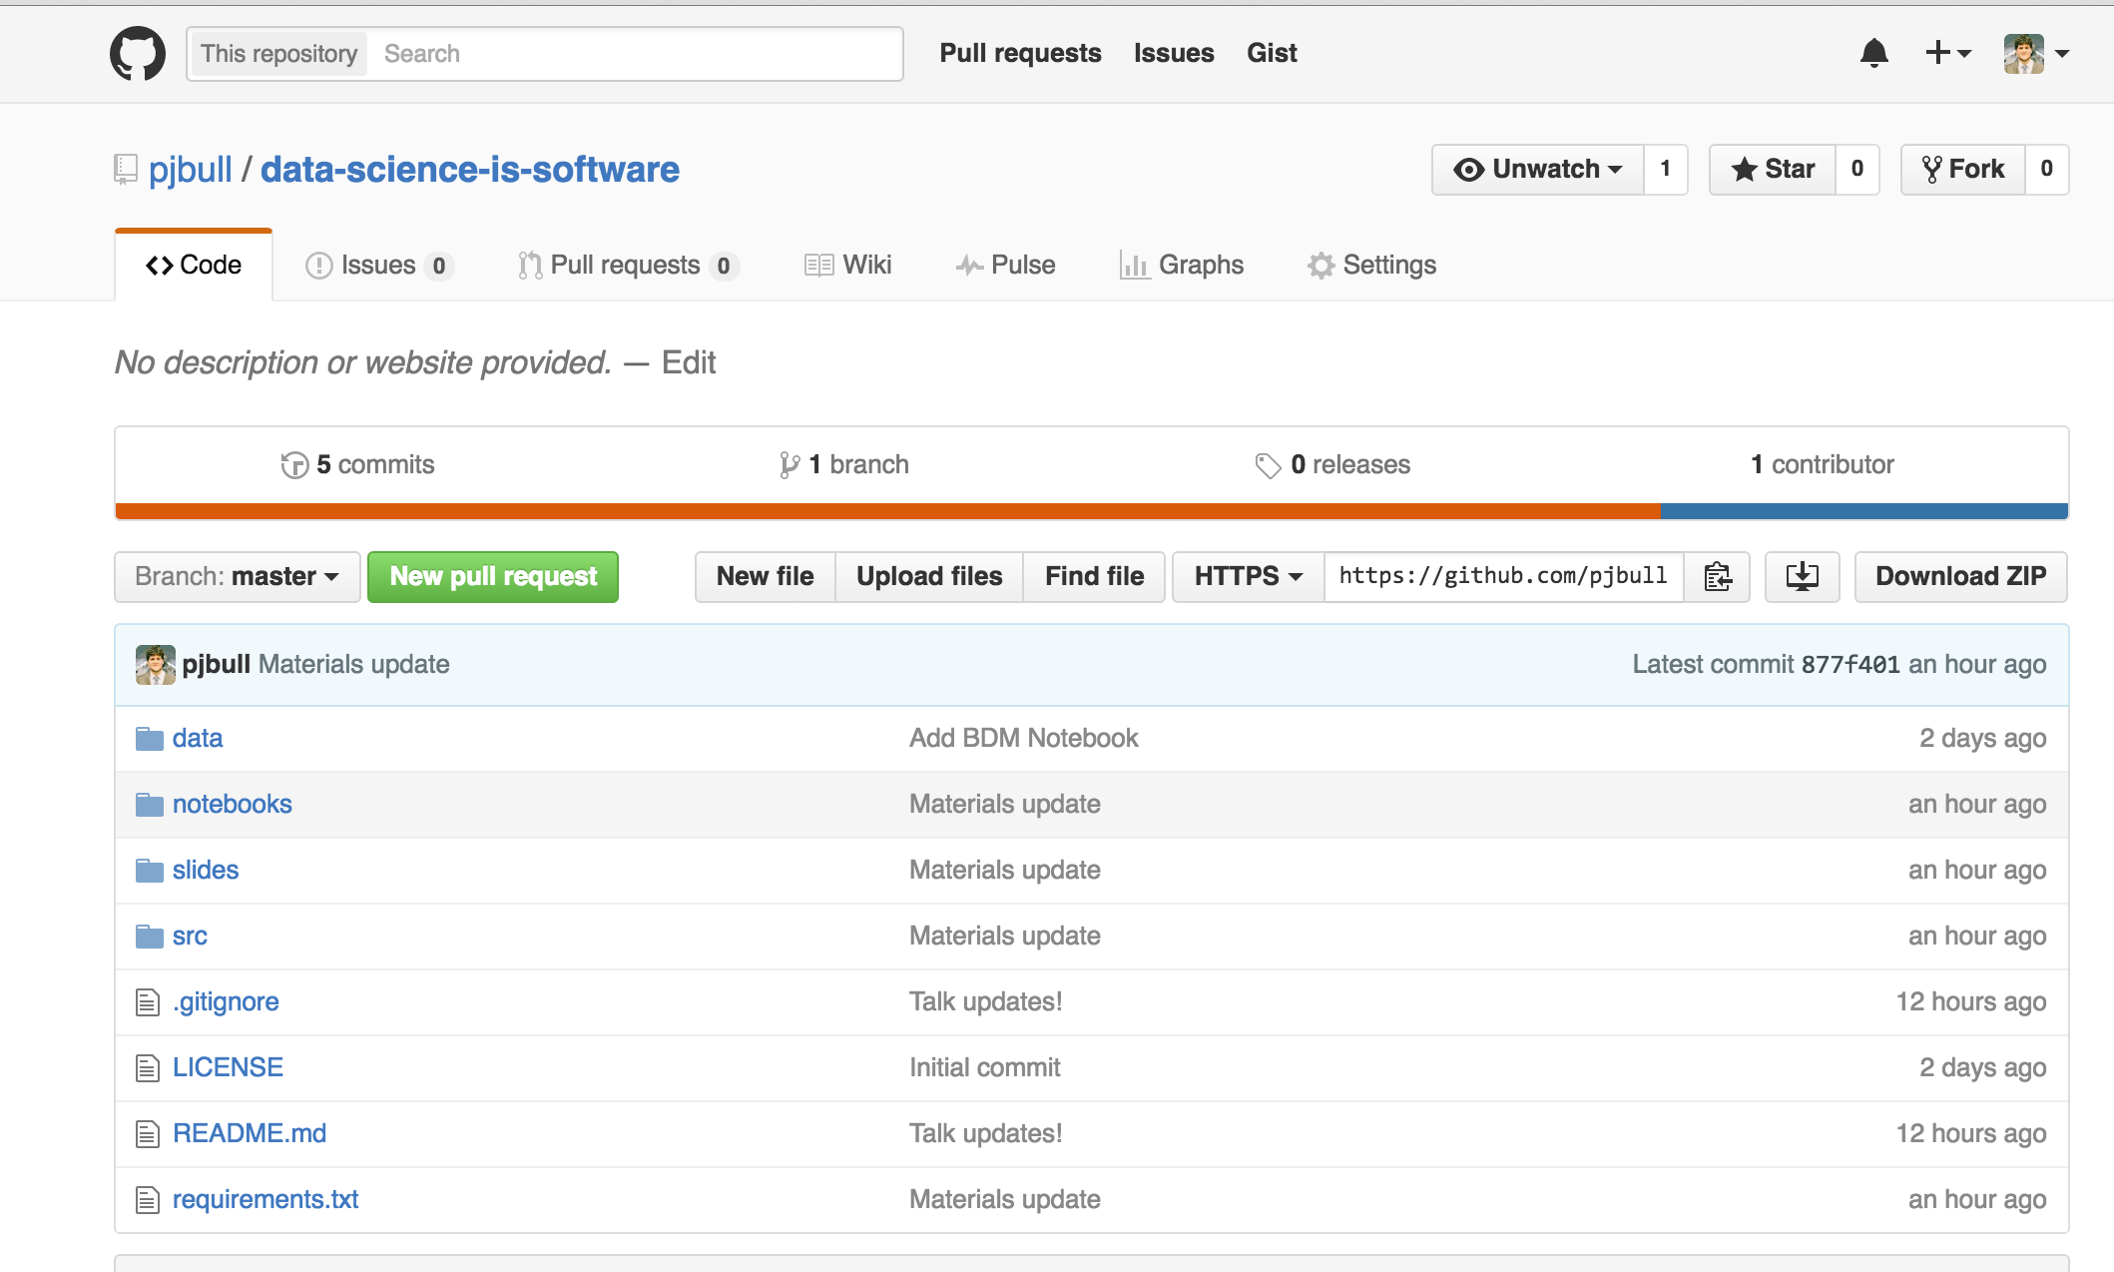
bit.ly/jupyter-lifehacks
OR
git clone
Notes:
- About me
- About DrivenData (hear more this afternoon)
- About this talk

Slide 3
“It's easy to enhance a FORTRAN compiler to compile COBOL as well; it's just a SMOP.”
— SMOP entry in The Jargon File
(a comprehensive
compendium of
hacker slang)
Notes:
- This is a prevailing attitude about data science

Slide 4
Notes:
Steve McConnell, Code Complete: A Practical Handbook of Software Construction, Second Edition
- Lots of good reasons for these, but I want to frame this as an exercise in empathy. Most best practices exist for two reasons:
> Anyone you may collaborate with
> Future you

Slide 5
1
This is my house

Slide 9
watermark
VIRTUALENV
virtualenvwrapper
Pip requirements.txt

Slide 10
Other options
(for more complex environments)

Slide 11
2
The Life-Changing Magic of Tidying Up

Slide 12
Notes:
http://smile.amazon.com/gp/product/B00KK0PICK/ref=dp-kindle-redirect?ie=UTF8&btkr=1

Slide 13
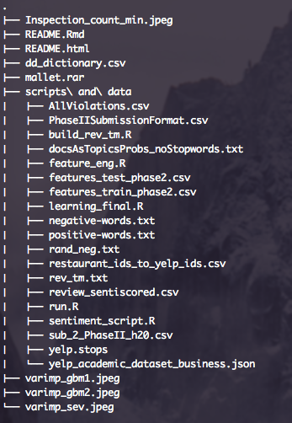
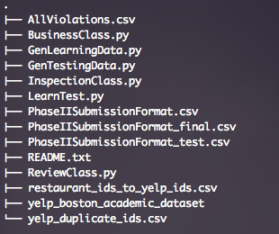
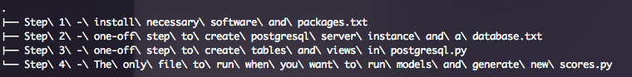
Notes:
From competition

Slide 14
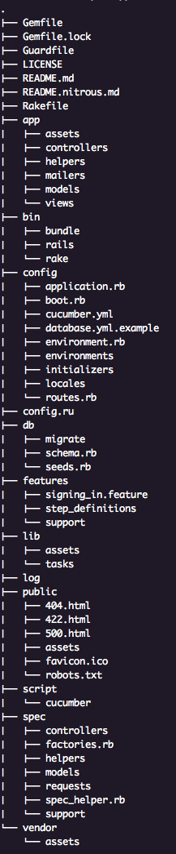
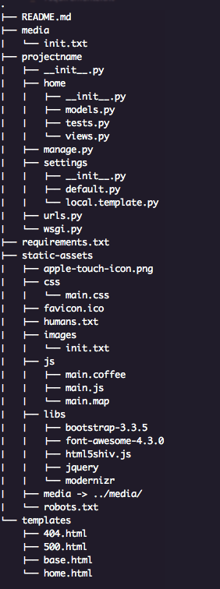
Ruby on Rails
Application
Django
Application

Slide 15
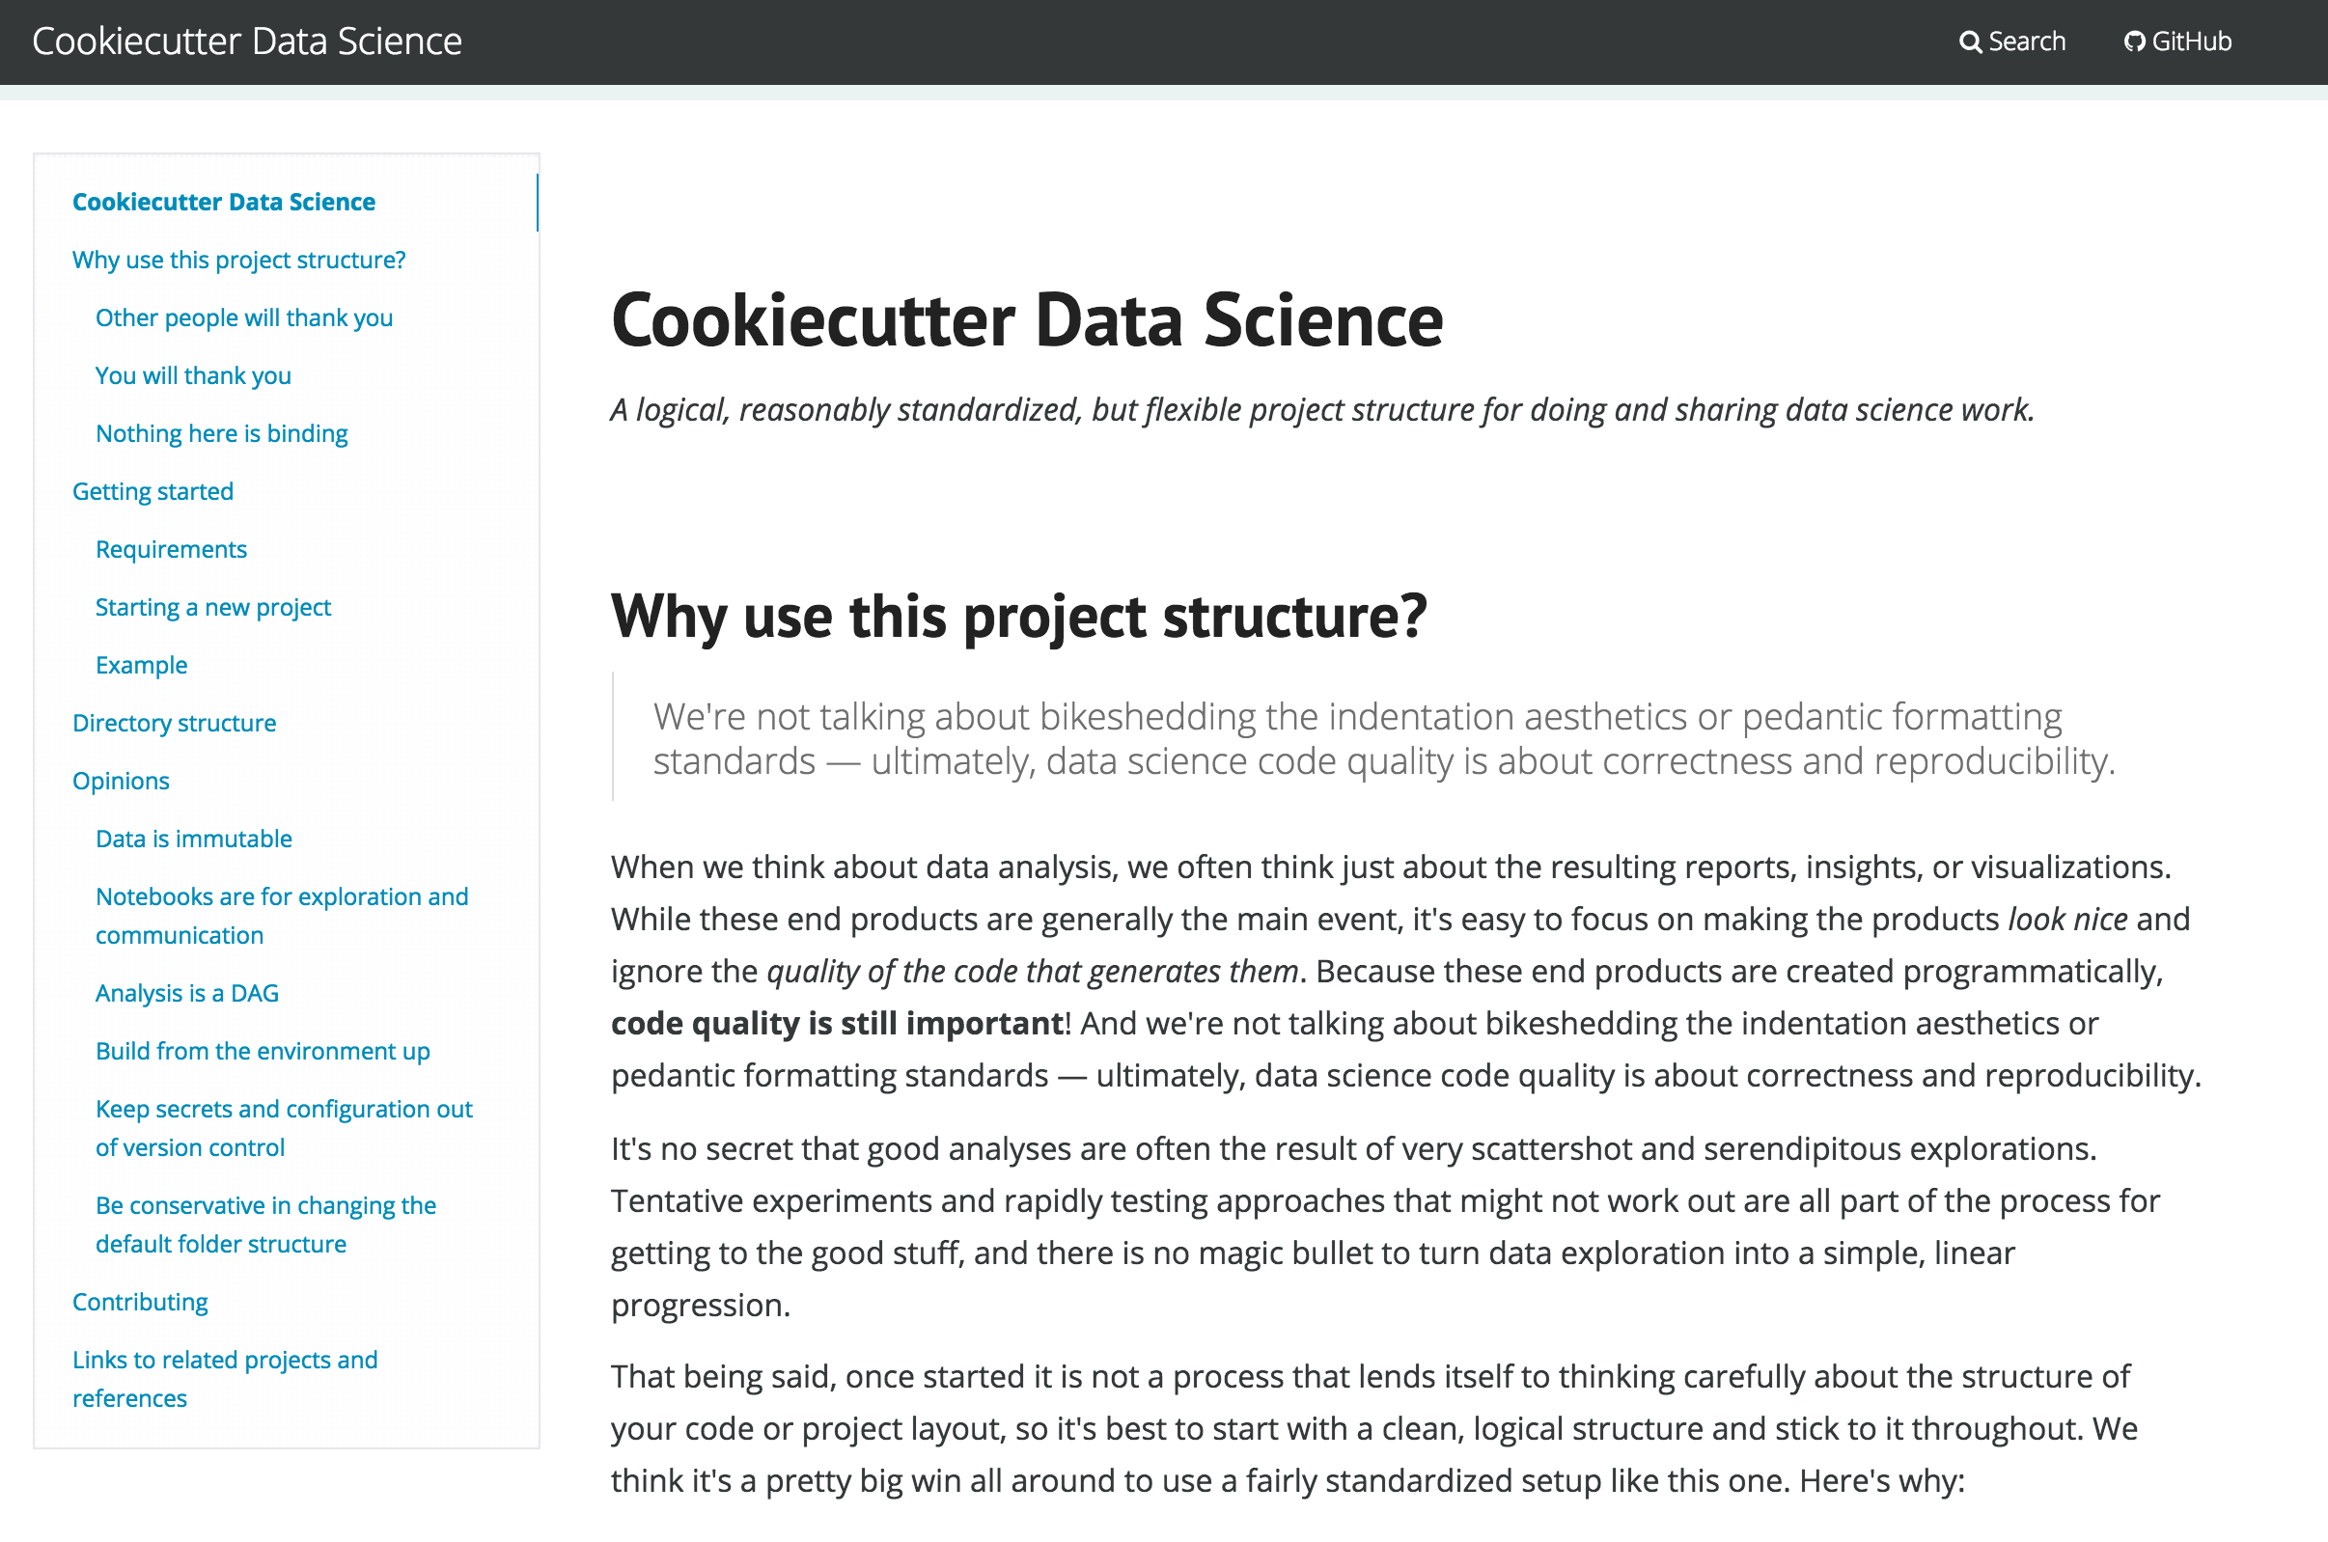
drivendata.github.io/cookiecutter-data-science
Notes:
Released soon as cookiecutter template!

Slide 16
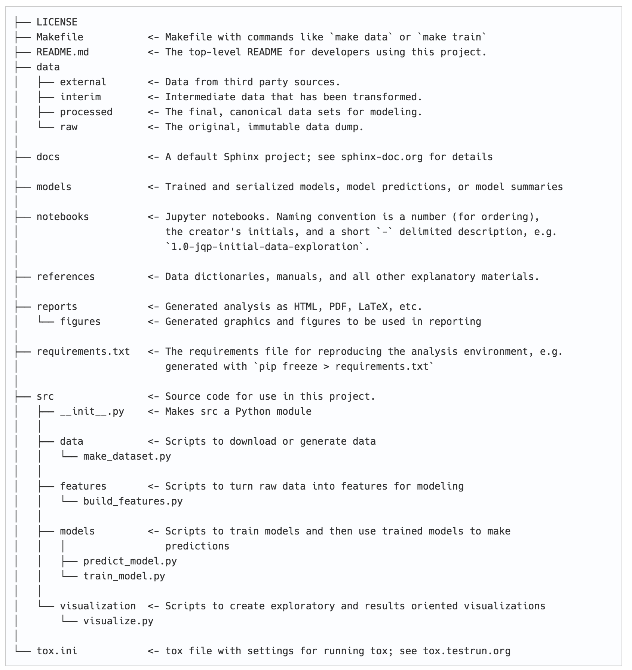
Notes:
Released soon as cookiecutter template!

Slide 17
3
Edit-run-repeat:
Stopping the cycle of pain

Slide 18
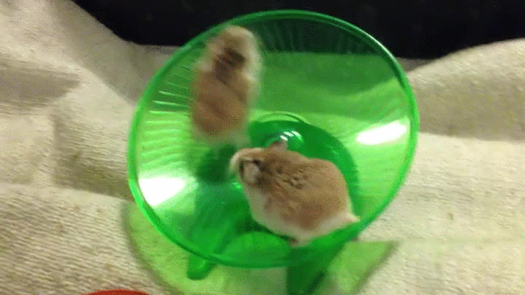

Slide 20
Autoreload, pdb, debug
Q, modules
Assert, Unittest
Engarde, numpy.testing

Slide 21
4
Next-level code inspection

Slide 22
Notes:
- unexplored map for coverage

Slide 24

Notes:
- %timeit and %prun for profiling

Slide 26

Notes:
Linting + IDEs

Slide 28
COVERAGe.py
%prun
PYCHARM
FLAKE8 linting for sublime

Slide 29
Not Covered
Version Control | git
Code review | git branch + pull requests
Branching strategy | GitHub Flow
Issue tracking | GitHub Issues + waffle.io
Automating workflows | Make
Documentation Generator | Sphinx
Docstrings | Sphinx ReST
Style guide | flake8
Notebook diffing | nbconvert to .py on save
Configuration isolation | config.py
Continuous Integration | Codeship

Slide 30
Questions?
DRIVENDATA
@drivendataorg / @pjbull
peter@drivendata.org
Notes:
- linting
- unit testing
- watch window
- on save hooks

